Slide 1

DESIGN PROJECT 3:WEEKLY PROGRESS 2
TICKET VERIFIER
PASSY MUKUNA LUFULUABO
Student Number :215270835
Lecturer/Supervisor: V Moyo
Date: 3/11/2019

Slide 2
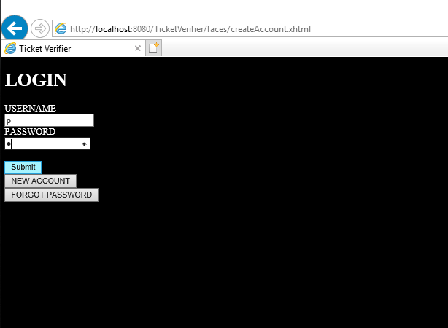
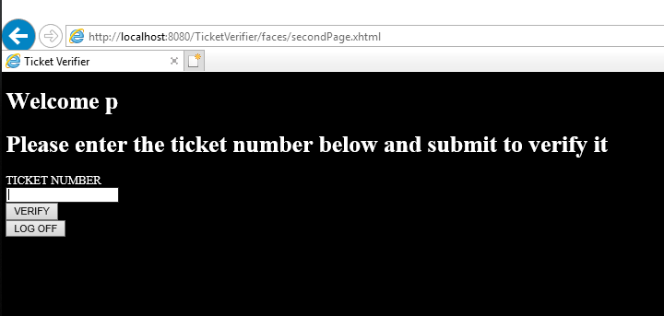
Login or welcome page
The main function page

Slide 3
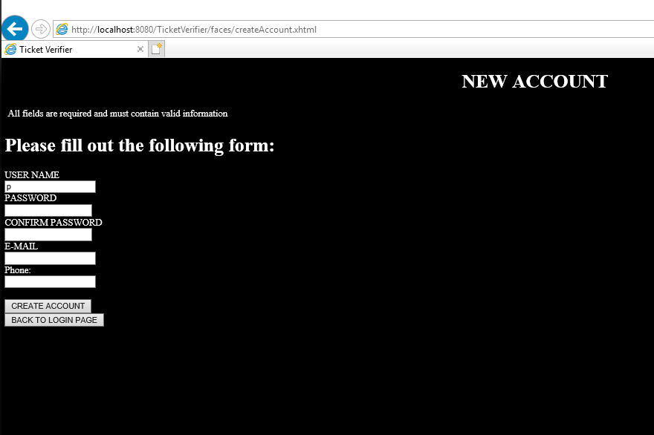
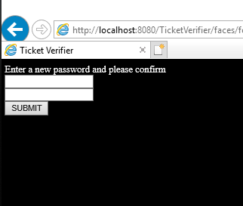
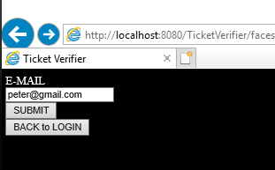
New account page
Forgot password navigation pages

